Slide 1
Project Fairway: Azure Network Topology Design
DRAFT

Slide 2
Agenda
01
02
03
04
05
06
Azure Network Topology Strategy
Architecture Overview
Core Elements
Connectivity Architecture
Interconnect Architecture
Questions & Next Steps

Slide 3
Network Topology and Connectivity
Azure Foundation Architecture and Hybrid Integration Strategy
Introduction: The next sections provide design considerations based on best practices, Microsoft CAF (Cloud Adoption Framework) and Accenture team accumulated experiences implementing Azure network architectures. Additionally, the sections addressing design decisions is based on ongoing discovery with Accenture and FedEx team members.

Slide 4
Assumptions
Prioritizing security from the ground up, no "isolated pockets" of networking without central security.
Hub NVA (Network Virtual Appliance) firewalls act as the route engine, managing traffic flow and inspection for all intra-Azure and hybrid network traffic
FXF Azure environment will be a "greenfield" deployment
FXF Azure cloud will be integrated with on-prem network consisting of a shared MPLS (Multiprotocol Label Switching) and SD-WAN (Software-Defined Wide Area Network) environment that connects all their physical locations back to their data centers.

Slide 5
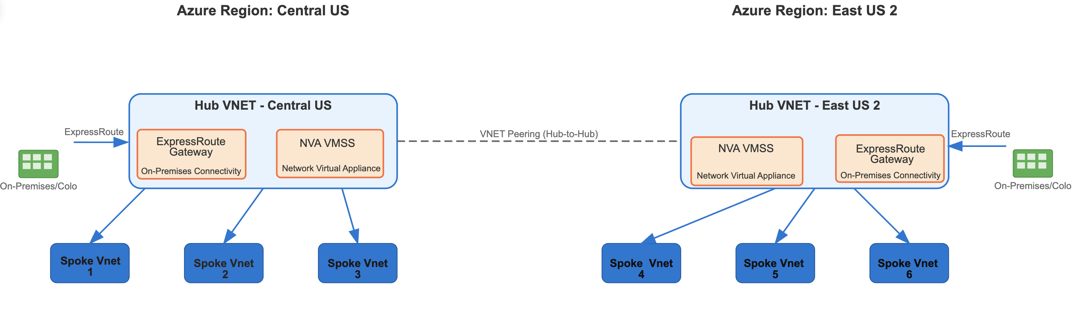
Azure Network Topology Strategy
Options: Hub-Spoke Architecture vs Azure vWAN
Traditional Hub-Spoke (Recommendation) Unmanaged topology with complete control and proven security patterns
Azure vWAN: Managed service with built-in routing, but less granular control
Traditional hub and spoke provides control over User Defined Routes (UDRs) and Network Virtual Appliances (NVAs)
Limited integration of solutions like Zscaler, Check Point using Azure Virtual WAN (vWAN) routing intent feature.
Reduces operational risk by keeping network architecture decisions in-house
Traditional Hub-Spoke Diagram

Slide 6
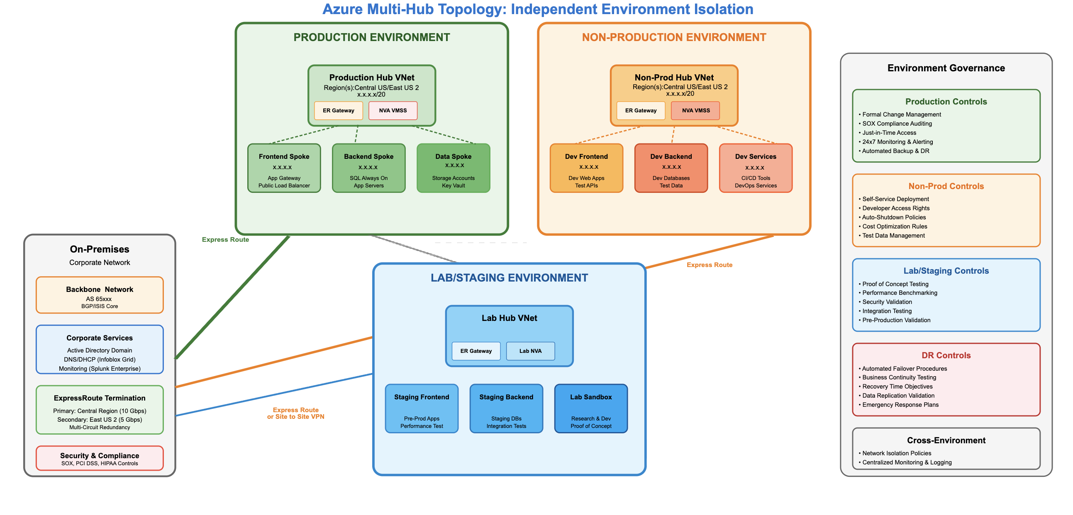
Azure Network Topology Strategy
Production and Non-Production Environment Separation
Central and East US 2 Environments
Production
Non-Production
Lab/Staging

Slide 7
Connectivity Architecture
Network Traffic Flows for Consideration
On-Premises to Azure Hub (regional ExpressRoute Primary and Secondary)
ER Circuit (Primary)
On-prem DC
ER Gateway
NVA VMSS
Azure Hub VNet
Spokes/Workloads
ER Circuit (Secondary)
Hub to Hub inter-region connectivity will use FE (Front-End) and BE (Back-End) transit routes via NVAs between hub VNets (Virtual Network)
Hub VNet (Central)
NVA VMSS
FE Transit
NVA VMSS
Hub VNet (East)
BE Transit
Spoke to Hub to Spoke connectivity will use default route to NVA (no direct spoke to spoke peering)
default 0.0.0.0/0 -> NVA
X - No Peering
Spoke A
NVA VMSS
Hub VNet
Spoke B
Remote Access
Egress NAT/Inspection
Spoke (App/Workload)
NVA VMSS
FXF Hub VNet
Internet
Internet Egress traffic will exit via FXF Azure hub VNet
TLS/IPsec
Inline Inspection (Optional)
Remote User
VPN/ZTNA Edge
NVA VMSS
Hub VNet
Spokes/Apps

Slide 8
Connectivity Architecture
Key Architectural Core Elements
Design Decisions
Core Infrastructure - Contains hub VNets, ExpressRoute, and shared network services
Hub Subnets: Express Route (ER) Gateway, NVA/Firewall, DNS (Domain Name System)
Regional Strategy: Dual-region hub/spoke topology in Central US primary and East US 2 secondary
Security Controls: All traffic inspected through hub NVA, private IP enforcement
Management Structure: Dedicated management group for core infrastructure
Application Workloads - Contains applications via spoke vnets peering to hub vnets

Slide 9
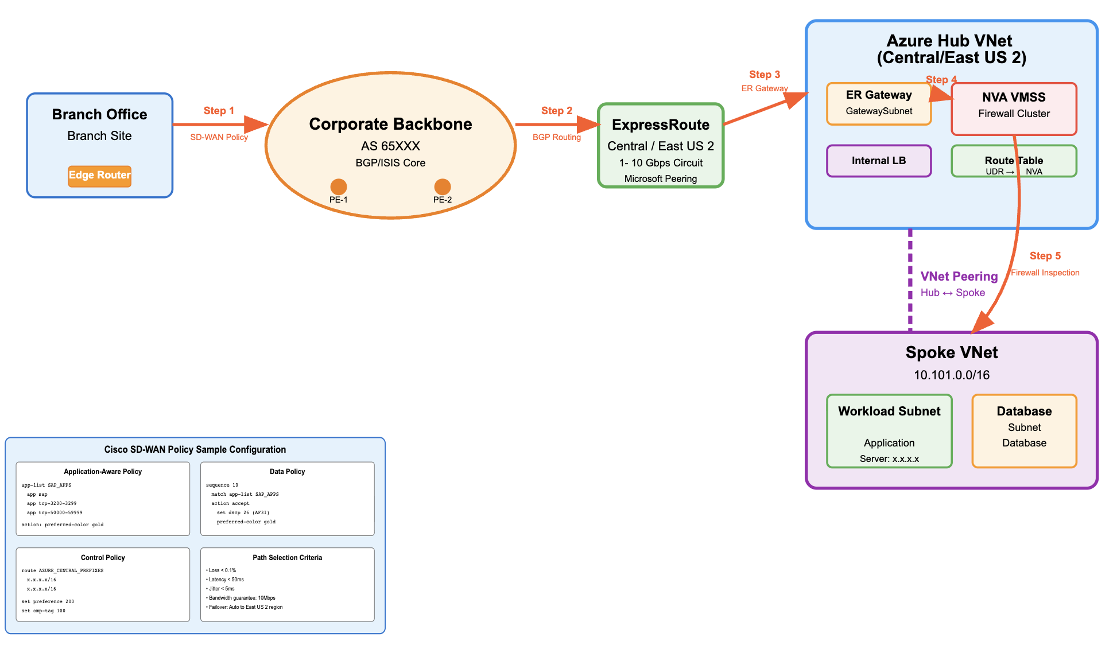
Interconnect Architecture
Branch (Edge) to Azure Traffic Flow via ExpressRoute Hub with NVA Inspection
Branch traffic flows through MPLS backbone (AS 65XXX) using policies (future state) for routing and path optimization
ECX (Equinix Cloud Exchange) ExpressRoute provides dedicated connectivity from core network to Azure Hub for inspection
Hub-and-spoke architecture routes traffic from Azure Central Hub to Spoke VNet application workloads
Notes:
network traffic flow analysis
step 1: branch office to mpls
traffic originates from the branch office with an edge router
sd-wan policy is applied at the branch level for traffic classification and routing step 2: mpls backbone transit
traffic traverses the mpls backbone (as 25676) using bgp/isis core routing
the backbone connects pe-1 and pe-2 provider edge routers
bgp routing determines the optimal path through the service provider network step 3: expressroute connection
traffic exits the mpls backbone and enters microsoft's expressroute in the central region
this provides a dedicated 1 gbps circuit with microsoft peering
expressroute offers predictable bandwidth and lower latency compared to internet routing step 4: azure hub vnet processing
traffic enters the azure hub vnet (central)
flows through the er gateway in the gatewaysubnet
security inspection occurs at the checkpoint vmss firewall cluster
route server (routeserversubnet) manages dynamic routing between on-premises and azure
internal load balancer distributes traffic as needed step 5: hub-to-spoke connectivity
vnet peering connects the hub to the spoke vnet
traffic reaches the workload subnet where the application workload resides
sd-wan policy configuration
the diagram shows sophisticated cisco sd-wan policies: application-aware policy: with preferred color gold for priority treatment control policy: routes azure central prefixes path selection criteria: ensures optimal routing with thresholds for loss, latency, jitter, and bandwidth this architecture provides application traffic with built-in redundancy, security inspection, and optimized routing policies.

Slide 10
Interconnect Architecture
Key Architectural Core Elements
Design Decisions
ECX serves as primary interconnect leveraging Cloud Exchange for Azure ExpressRoute circuits
Physical Circuit Isolation/Diversity: engineer dual ExpressRoute circuits with physical geographical diversity at Equinix facilities into MSEE (Microsoft Enterprise Edge) points of presence (POPs)
Implement a bow-tie topology by cross-connecting dual Azure Express Route circuits from distinct MSEE regions to Azure transit domain, each circuit can reach either hub. Support FE and BE VNets between hub regions with NVA inspection in path
VRF (Virtual Routing and Forwarding)-Based Routing: Ingress traffic from SD-WAN managed core is routed into Azure via a dedicated VRF instance for traffic isolation/separation
Subnet Specific Matching: The ingress path is configuration match traffic destined for subnet x.x.x.x, for control, allowing SD-WAN to direct traffic flow towards Azure.
SD-WAN Azure Labels for Policy Enforcement: A label is applied to the traffic entering Azure cloud policy enforcement.

Slide 11
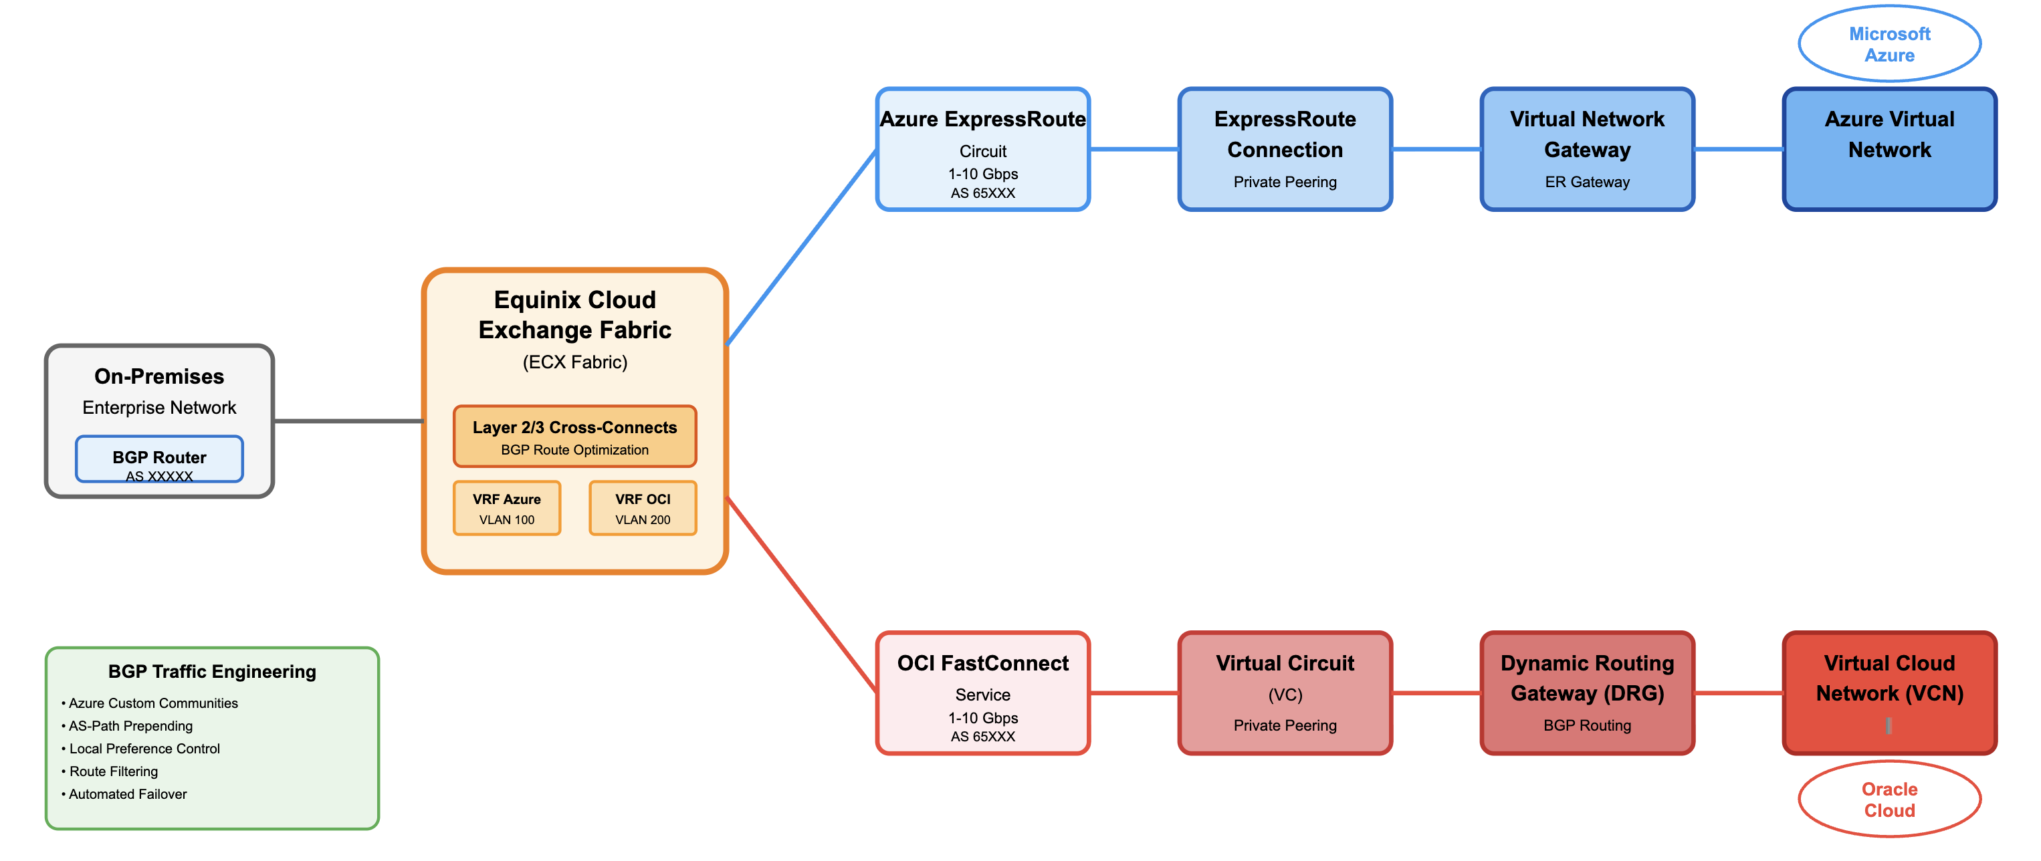
Interconnect Multi-Cloud Architecture
Design Considerations
Private interconnect via Equinix Fabric: ECX/Fabric L2 (802.1q) platform for private connect to Azure Express Route and OCI (Oracle Cloud Infrastructure) Fast Connect (and other clouds)
Separate VRFs per cloud (prod/dev) environments distinct virtual circuits; route leaking can happen at NVA
Azure BGP (Border Gateway Protocol) custom communities provide Azure specific routing intelligence; target specific Azure regions

Slide 12
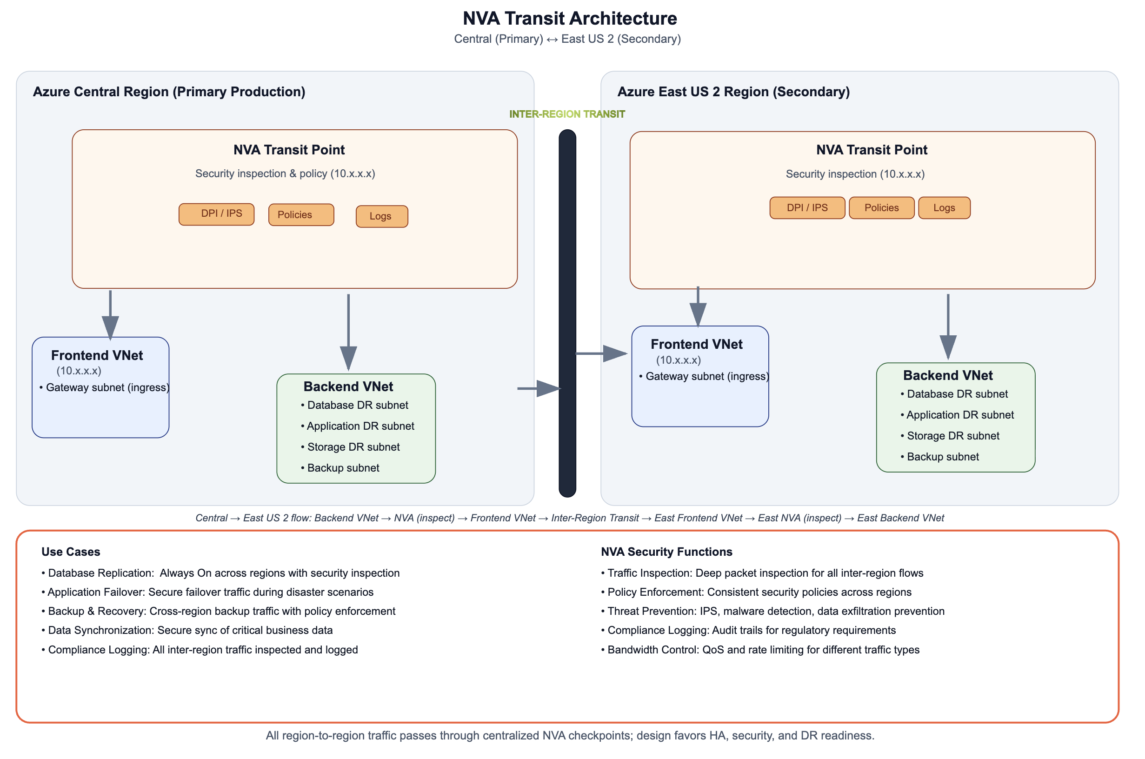
NVA Strategy
Check Point or Fortigate VMSS for scalable, security, policy management.
VMSS in hub VNets auto-scaling based on traffic demand
Azure Firewall NOT considered due no BGP peering functionality
Terraform, REST API Ansible modules enable Infrastructure as Code (IaC) deployments
eBGP (Exterior Border Gateway Protocol) peering with Azure Route Server route exchange between on-prem MPLS core(s)
VMSS scaling based on metrics (CPU, memory, session count, etc.)
Fortigate only features
Works with Cisco SD-WAN policies, Zscaler native integration for L7
Fortigate vSPUs

Slide 13
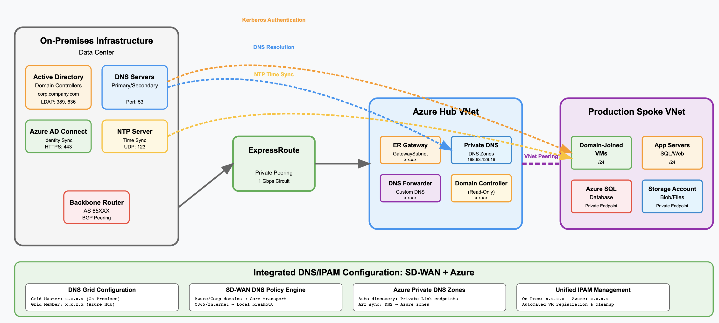
Azure DNS Services
Design Considerations
Deploy DNS forwarder VMs in Hub VNet, configure conditional forwarding to on-premises
Azure private DNS zones to all VNets

Slide 14
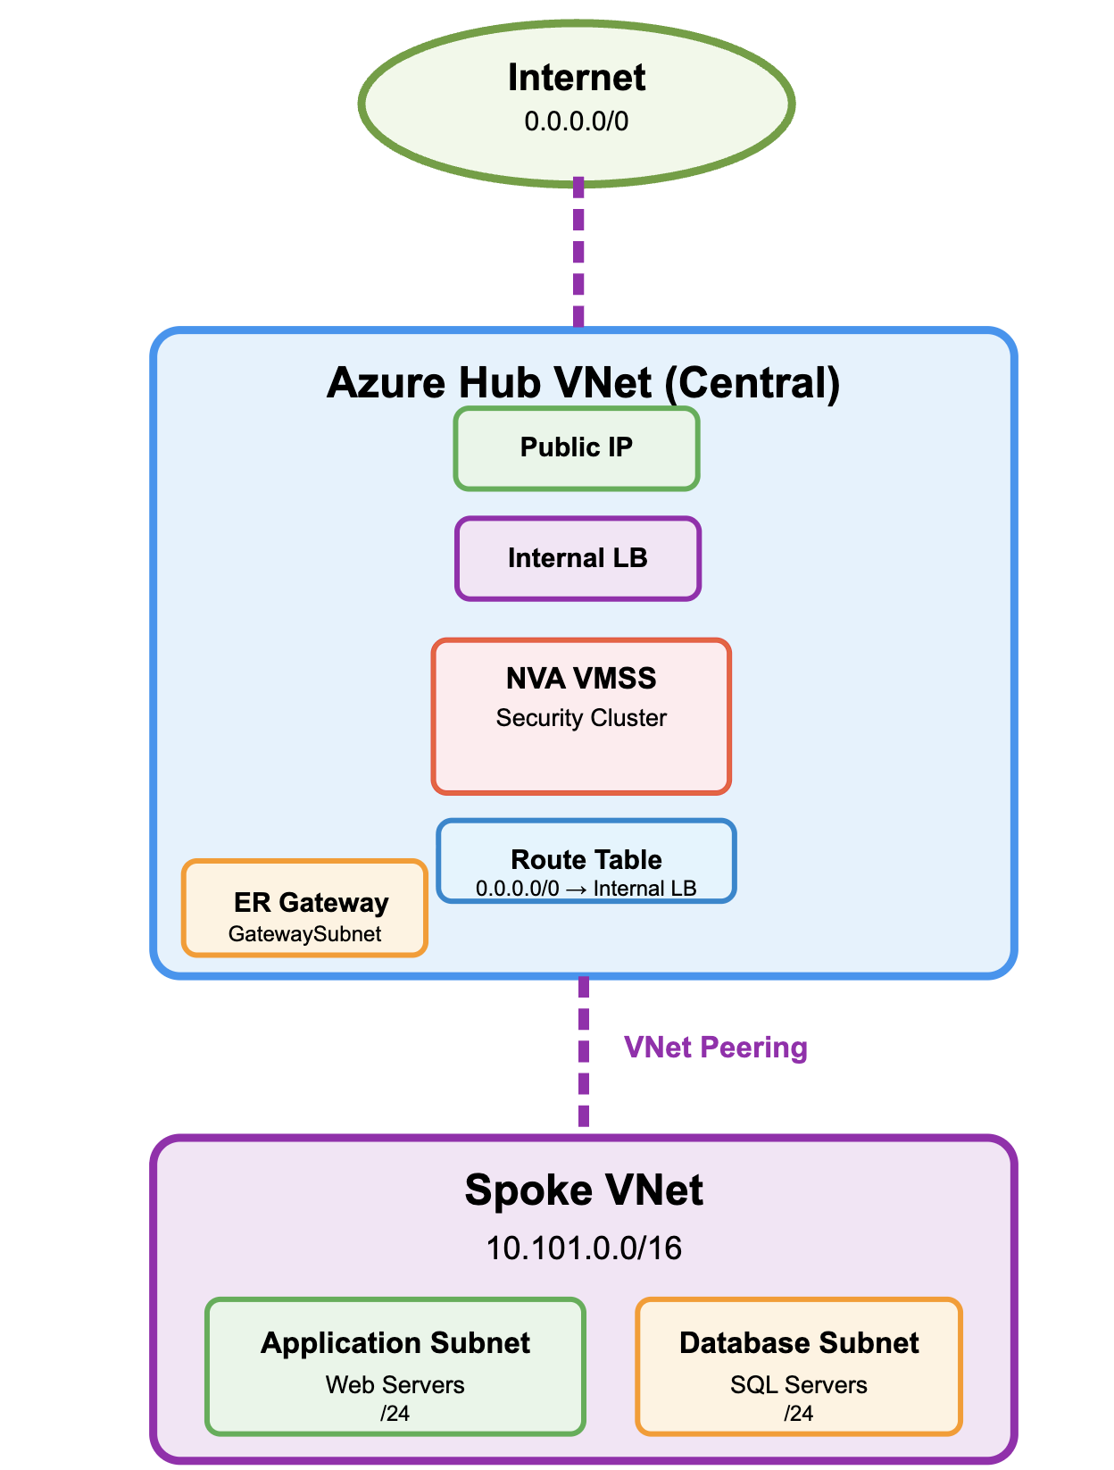
Internet Egress
Design Considerations
Internet Egress via FXF Azure Cloud (Recommended)
This solution provides immediate access to established security policies, threat intelligence, and logging (via NVA) deployed in Azure
Centralized security inspection - All internet traffic flows through hub NVAs for policy enforcement
Reduced operational complexity - Single internet breakout point simplifies NVA policy and monitoring of workflows
Consolidation, eliminates multiple NAT gateways across spokes, reducing processing charges
Forced tunneling via UDRs - Route tables override system routes, directing 0.0.0.0/0 through hub NVAs
SNAT/PAT centralization - Single NAT pool in hub eliminates
Asymmetric routing prevention - Hub-centric egress ensures return traffic follows same inspection path

Slide 15
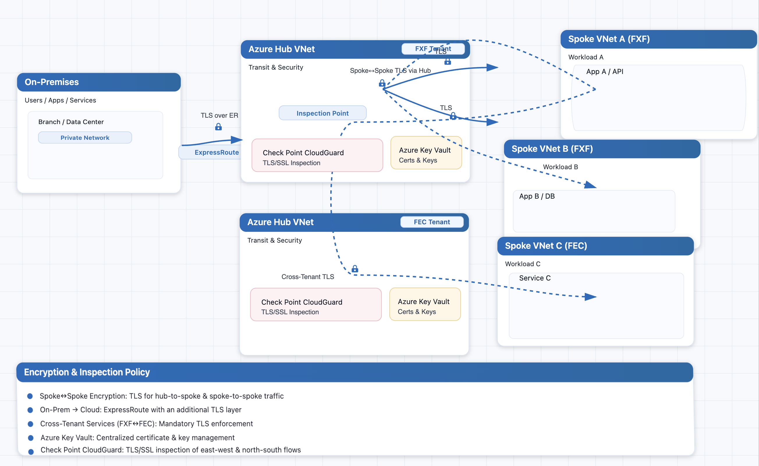
Network Encryption
Core Elements
Spoke to Spoke Encryption – TLS (Transport Layer Security) for hub-to-spoke and spoke-to-spoke traffic
On-Premises to Cloud Encryption - ExpressRoute with additional TLS layer
Cross-Tenant Security Enforcement - Mandatory encryption for FXF/FEC tenant services
Azure Key Vault - Centralized management
Check Point performs TLS/SSL (Secure Sockets Layer) inspection

Slide 16
Questions and Feedback

Slide 17
Next Steps

Slide 18
Appendix

Slide 19
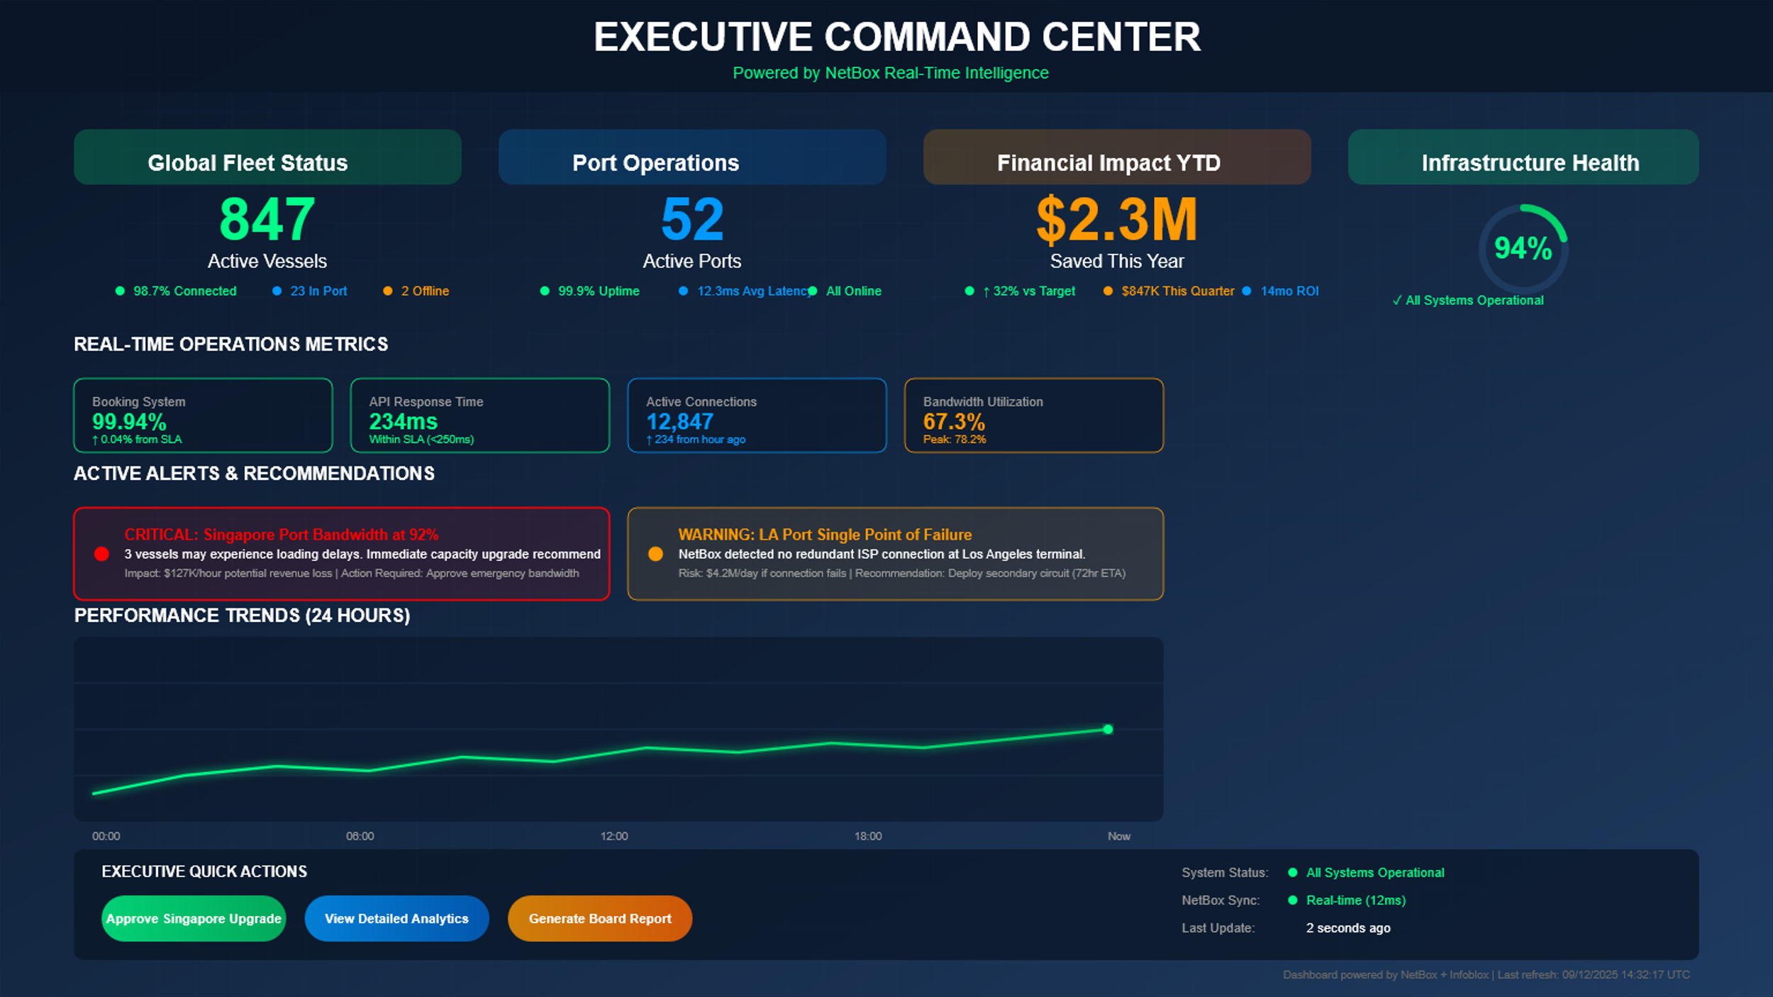
NetBox
Recommendation
Design Considerations
Multi-Cloud Visibility
For unified Azure / Oracle / On-Prem documentation
Future state, business goals modeling and capacity planning.
Model relationships across Azure subscriptions and management groups
Single view of clouds ER/FC circuits and Equinix cross-connects. Right size circuits
DNS modeling for on-prem and Azure cloud resolution chains

Slide 20
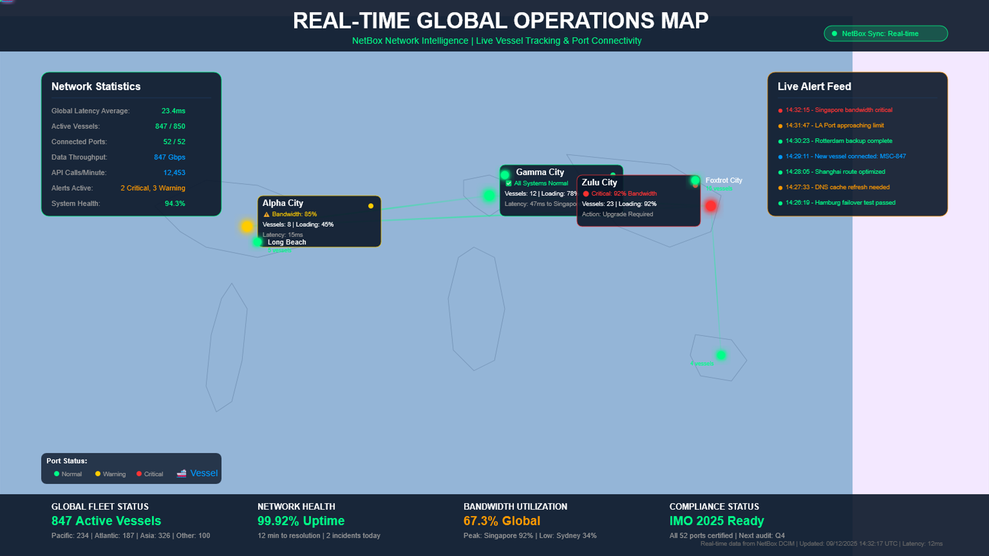
Observability Strategy
NetBox
Topology aware
Dynamic network Monitoring

Slide 21
Azure Network Topology Strategy
Core Elements
Network Architecture Foundation
Security Architecture
Management Structure
Traditional Hub and Spoke: Selected over Azure vWAN for complete control
Dual Regional Design: Central US (primary) and East US 2 (secondary)
VRF Segmentation: Azure as distinct VRF for routing isolation
Zero Trust Design: Security-first architecture from day one
Check Point CloudGuard VMSS: Auto-scaling firewall clusters
Private IP Enforcement: Azure Policy prohibits public IPs
TLS 1.3 Encryption: All traffic flows encrypted in transit
Centralized Inspection: All traffic through hub firewalls
Core Infrastructure : Hub VNets and shared services
Workload Subscriptions: Application spoke VNets
Management Groups: Core Infra, Production, Non-Production
Policy Enforcement: Automated governance and compliance
Connectivity Infrastructure
Automation Deployment
Observability Strategy
Equinix Cloud Exchange: Primary interconnect for ExpressRoute and OCI
Dual ExpressRoute: Physical diversity with bow-tie topology
Cisco SD-WAN Integration: Catalyst overlay with 8000V edge devices
Site-to-Site VPN: Backup connectivity for resilience
Infrastructure as Code: Terraform primary, Bicep/ARM (Azure Resource Manager) as alternatives
Pipeline Deployment: Automated CI/CD with gates and approvals
Subscription Vending: Standardized provisioning workflows
Policy as Code: Governance automation and drift prevention
Hybrid Monitoring: Extend Prometheus/Grafana or Azure-native
Log Analytics Consolidation: Reduce from 17 to fewer workspaces
Network Watcher: Azure-native network monitoring
SIEM (Security Information and Event Management) Integration: Existing Splunk or Azure Sentinel options

Slide 22
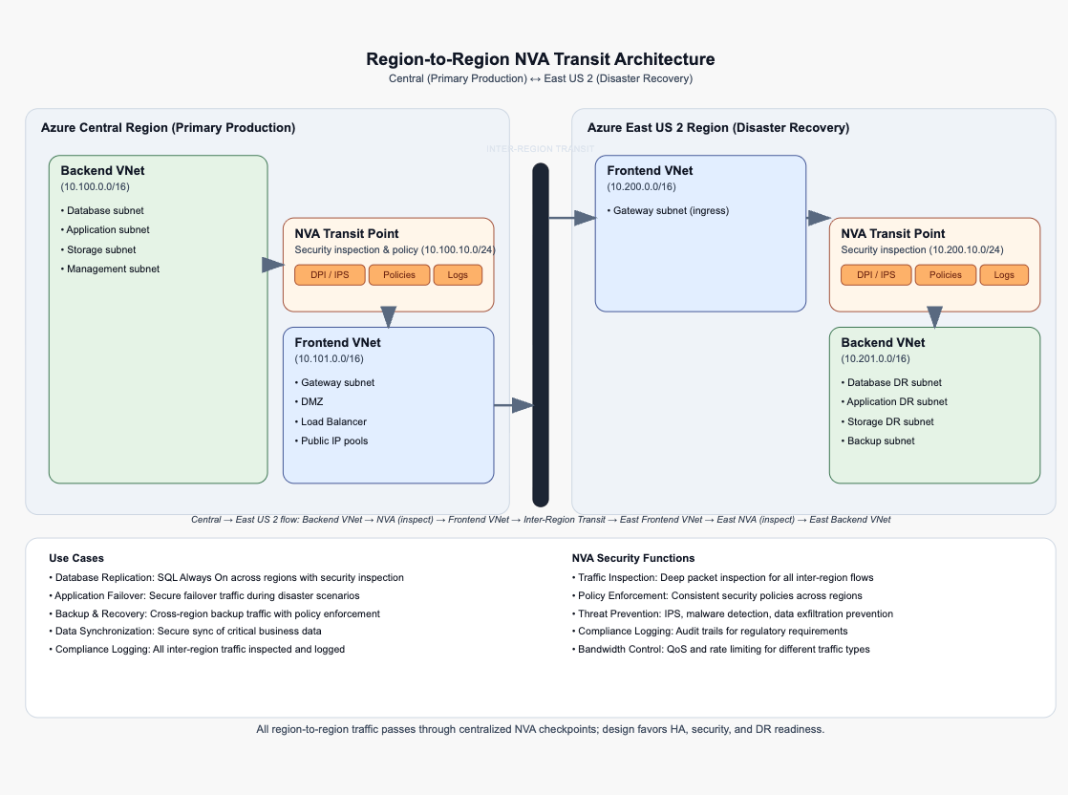
Region to Region Architecture Strategy
Recommendations are based on compilation of NIST (SP 800-207) and CAF guidelines
Design Considerations
NVAs are security transit points to/from both regions with inspection at ingress and egress FE and BE VNet peering
Aligns with NIST zero trust model for continuous resource identification and CAF workloads using identity, policy, security controls
Central boundary security and segmentation with policies, monitor and control communications at external/internal boundaries, enforce approved info flows
FE can failover (no BE impact), replication can be send over single VNet instead so not impact day to day prod workloads
Internet traffic only on FE VNet

Slide 23
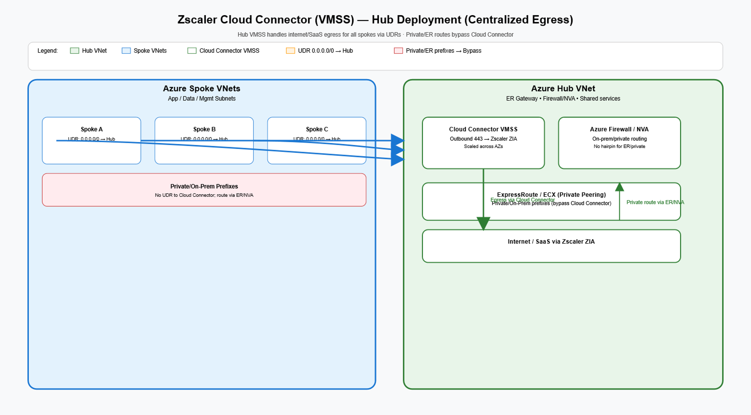
Remote Access
Design Considerations

Slide 24
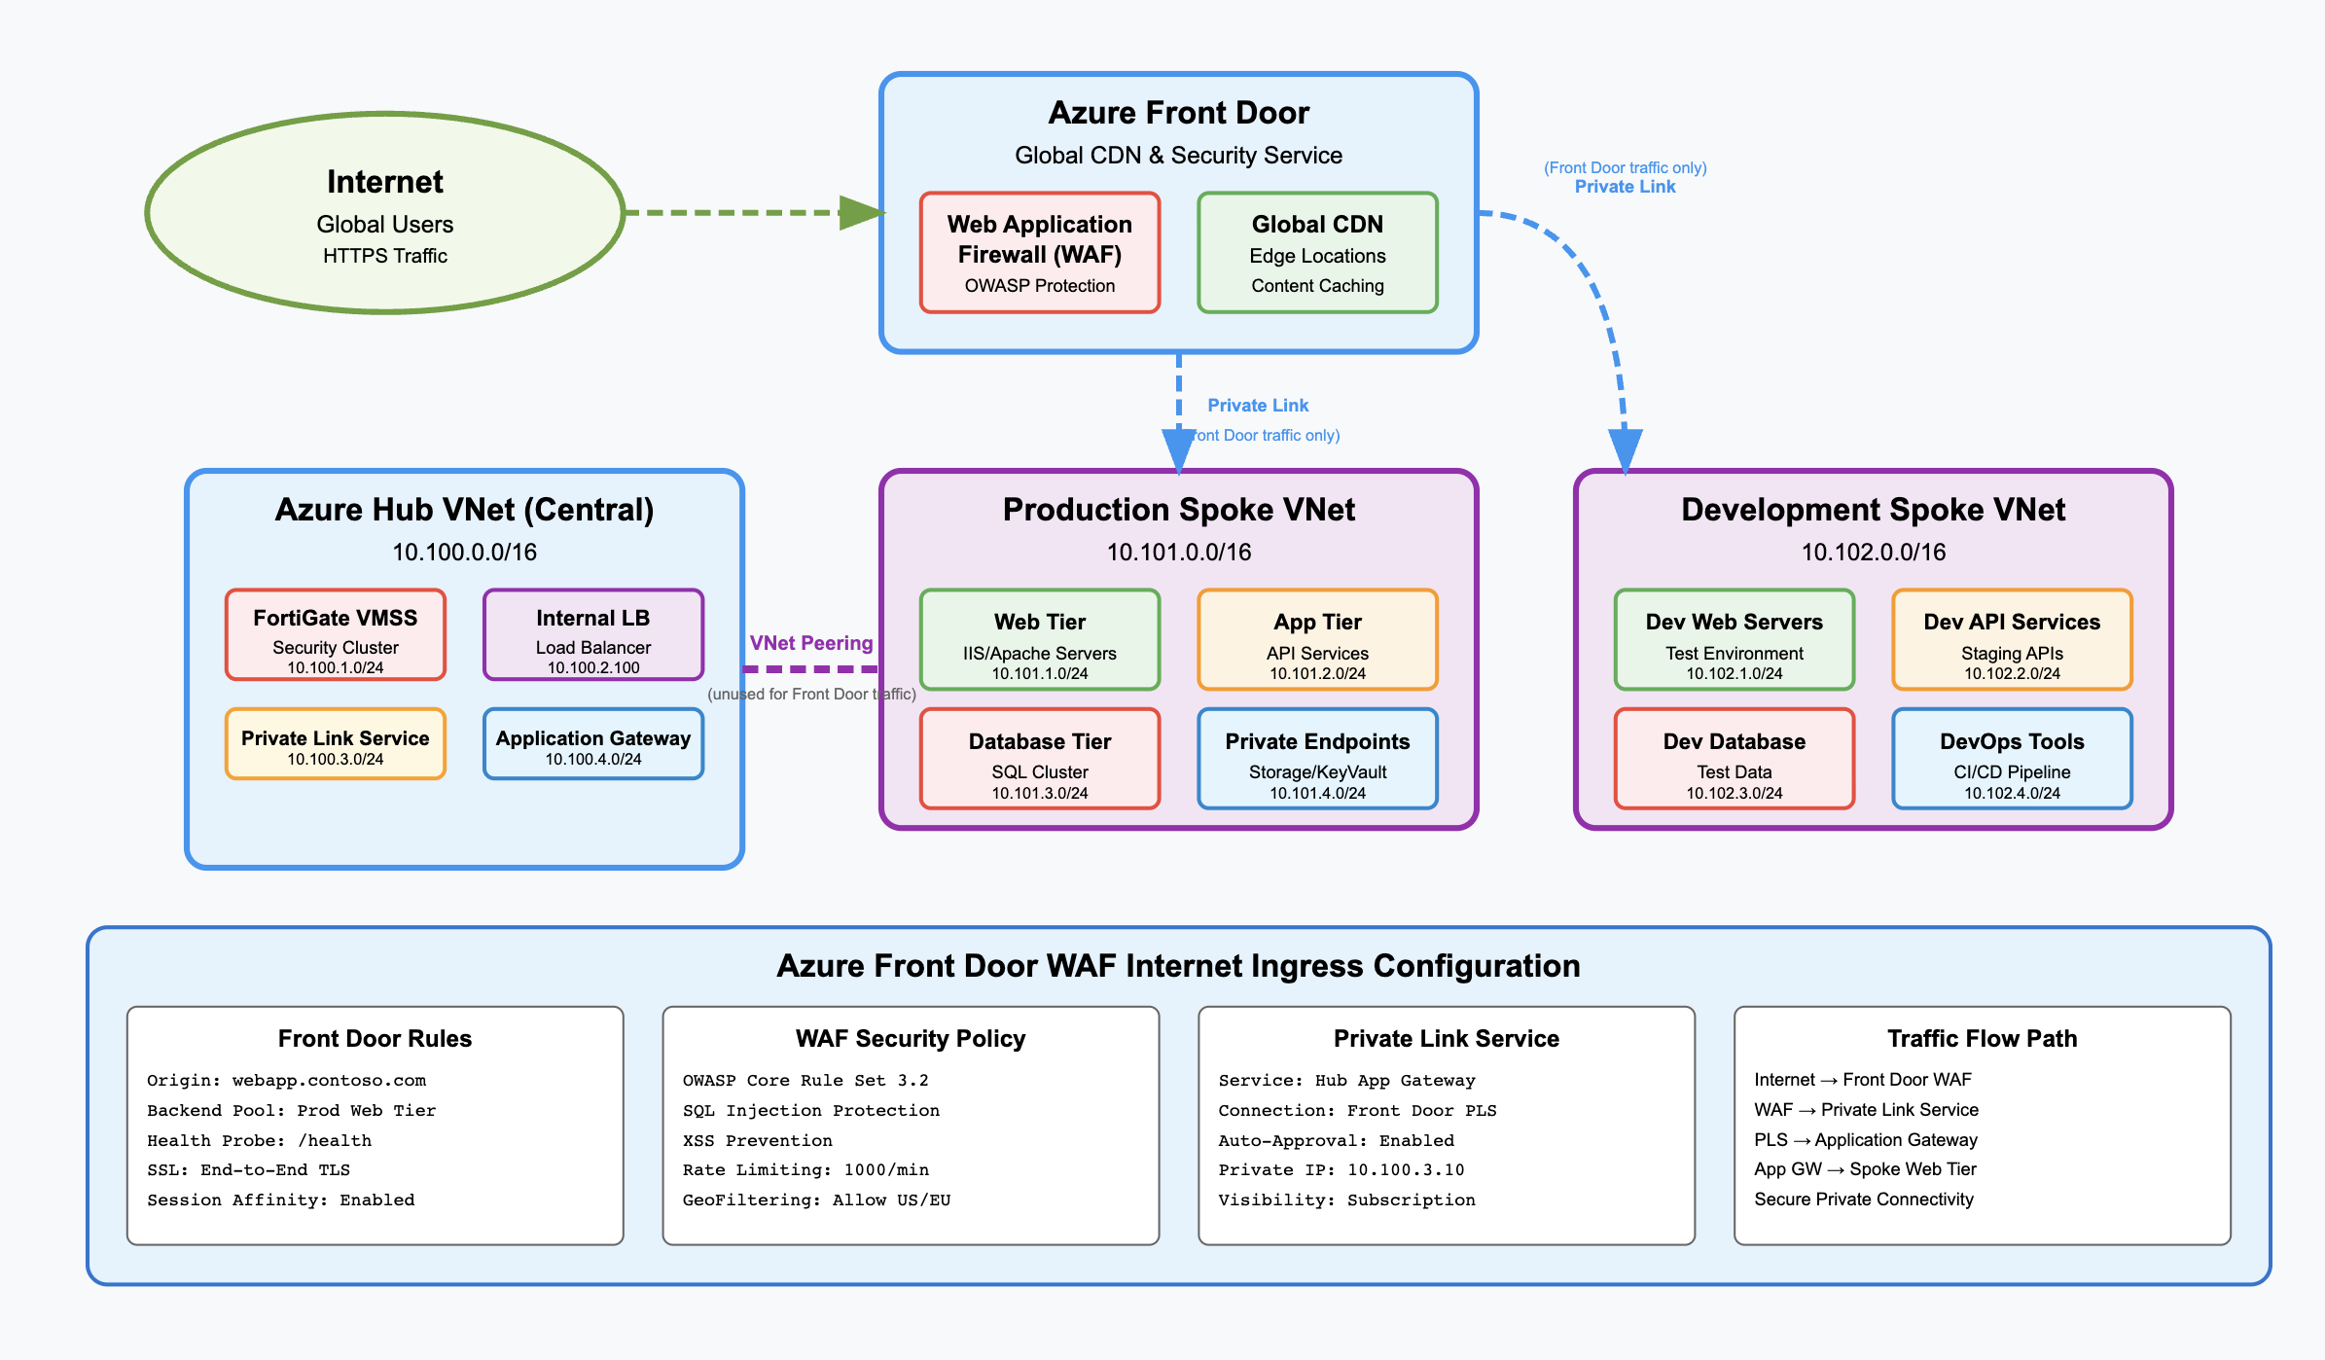
Internet Ingress Strategy (Post-TSA)
Design Considerations
Azure Front Door with Private Link (PL) and spoke LB
No hub transit for Internet ingress or hair-pinning through NVAs
Security at the edge using WAF (Web Application Firewall)
Traffic uses Microsoft backbone
Anycast edges for availability and failover.
Notes:
Azure Front Door with Private Link (PL) and a load balancer in the spoke; origin/source set to PL only.
Security at the edge using WAF; attack prevention before reaching Azure
Traffic uses Microsoft backbone; Anycast edges for availability and failover.
Anycast edges for availability and failover.

Slide 25
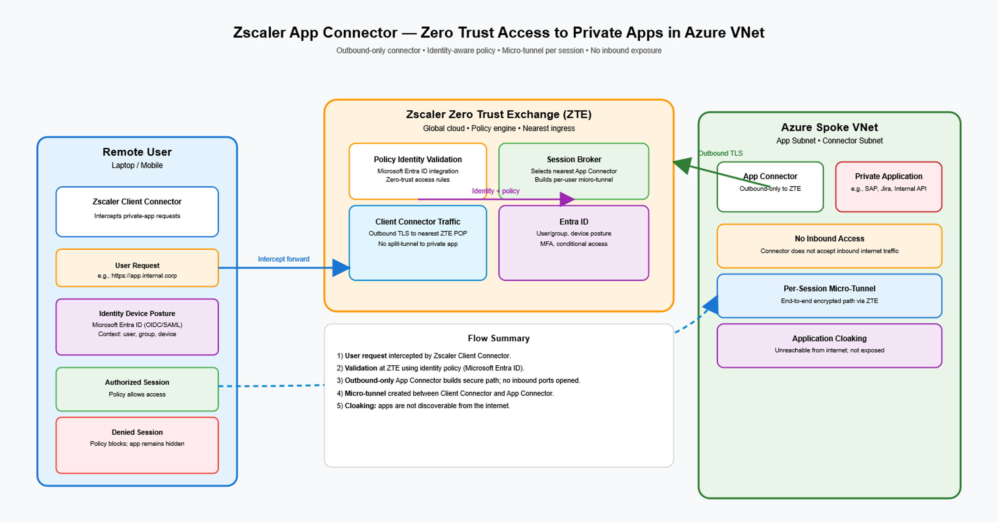
Remote Access

Slide 26
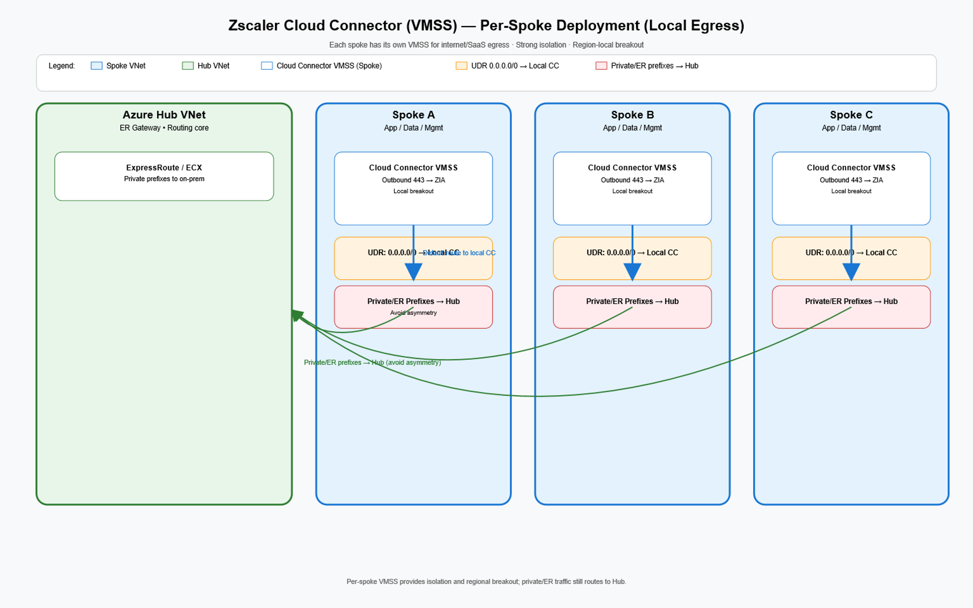
Remote Access

Slide 27
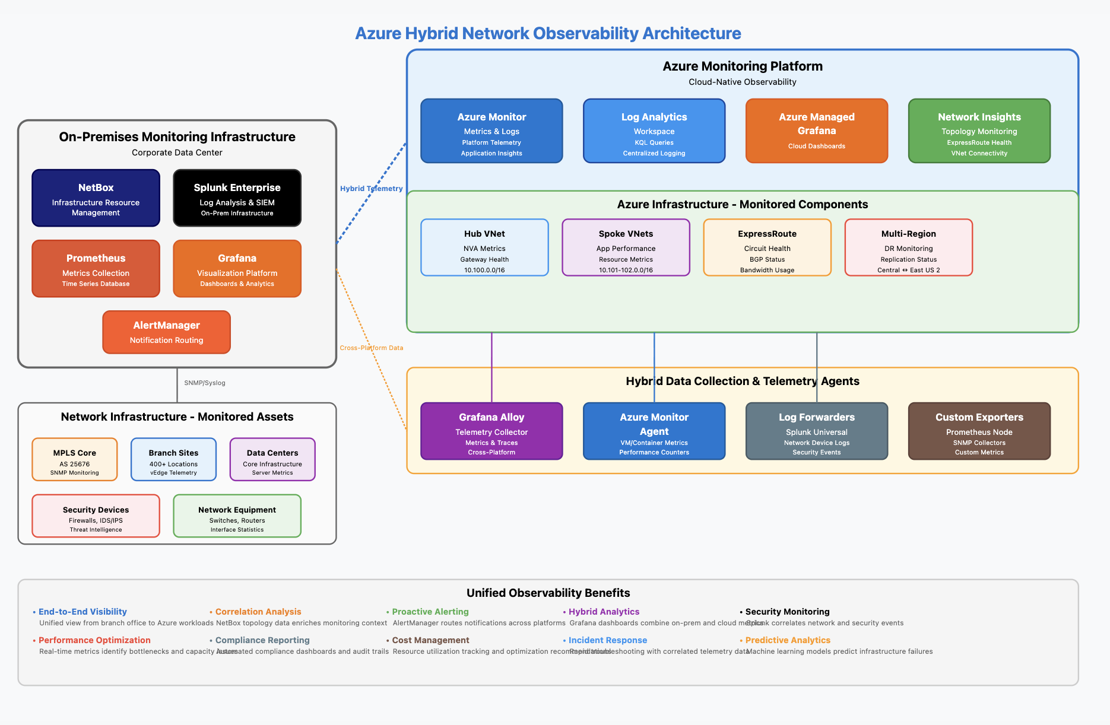
Observability and Monitoring
Core Elements
Option 1: Hybrid Extension of On-Premises Solution​
Federated Monitoring with the existing monitoring stack: Extend current Prometheus/Grafana/Splunk infrastructure to Azure through Azure Monitor integration and Prometheus federation to exporter/collectors Azure​
​Option 2: Azure-Native Observability with Hybrid Integration​
Implement Azure Monitor, Log Analytics, and Application Insights platform for all Azure resources with data federation to on-premises Splunk/Prometheus. ​
This design consideration utilizes native Azure capabilities, automated scaling insights, and integration while implementing custom logic apps and Azure Functions to replicate critical metrics to existing Prometheus instances

Slide 28
IP Addressing and Management
Design Considerations
Option 1: Hybrid IPAM with Gradual Azure Native Transition
Phased IPAM Migration Strategy: Maintain Infoblox as the authoritative source for all IP allocations during initial Azure deployment as a secondary system for cloud-native subnet management.
Option 2: Azure Native IPAM with Infoblox Integration
Azure IPAM as Primary with Infoblox Federation: Implement Azure as the primary IP address management platform for all cloud resources while maintaining Infoblox integration for on-premises DNS/DHCP services
Use API for synchronization. This design decision provides centralized visibility and integrates well with PowerShell/Terraform automation pipelines

Slide 29
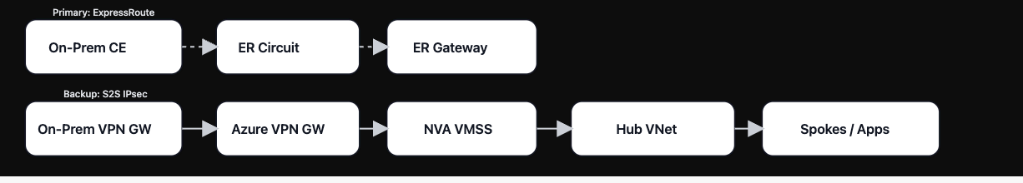

Additional Traffic Flows
Site to Site VPN (can be used as backup for telco delays)​
Internet Ingress traffic

Slide 30
Glossary

Slide 31
Hub-and-Spoke Architecture – A traditional Azure topology where a central hub VNet provides shared services (firewalls, gateways) to multiple spoke VNet hosting workloads.
Azure vWAN (Virtual WAN) – Microsoft-managed networking service with simplified routing and connectivity, but less granular control compared to hub-and-spoke.
ExpressRoute – A private, dedicated connection between on-premises infrastructure and Azure, offering predictable latency and reliability compared to internet VPN.
Site-to-Site VPN – Secure IPsec tunnel between on-premises networks and Azure VNets, often used as a backup to ExpressRoute.
Equinix Cloud Exchange (ECX) – Interconnection service used to link Azure ExpressRoute circuits with other clouds or on-premises networks.
SD-WAN (Software-Defined WAN) – Overlay technology that uses software policies to manage connectivity across MPLS, internet, and cloud networks.
Check Point CloudGuard VMSS – Cloud-native firewall solution deployed as a Virtual Machine Scale Set for scalable security enforcement in Azure.
NVA (Network Virtual Appliance) – Virtualized network function (e.g., firewall, router) running in Azure for traffic inspection and routing.
UDR (User-Defined Route) – Custom route table in Azure that forces traffic through a specific path, typically through a firewall.
VRF (Virtual Routing and Forwarding) – Logical routing table segmentation for traffic isolation across multiple tenants or environments.

Slide 32
Zero Trust – Security model that assumes no implicit trust; all traffic must be verified, inspected, and explicitly allowed.
TLS 1.3 – Latest version of Transport Layer Security, ensuring data encryption in transit.
Azure Key Vault – Managed service for secure storage and management of cryptographic keys and certificates.
Observability – End-to-end monitoring strategy using metrics, logs, and traces (e.g., Prometheus, Grafana, Azure Monitor, Log Analytics).
L2 802.1Q - Ethernet standard that adds a small “tag” so multiple isolated networks (VLANs) can share the same physical link.

Slide 33
Network Segregation Strategy
Core Elements
Network Segmentation Strategy | Implementation Details
Hub-Spoke Isolation with Centralized Security | All spoke vnets connected to hub through vnet peering with User-Defined Routes (UDRs) forcing traffic through Check Point CloudGuard VMSS firewalls for inspection, logging, and policy enforcement before reaching destinations
Zero Trust Spoke-to-Spoke Communication | Direct spoke-to-spoke connectivity prohibited through disabled gateway route propagation and explicit firewall rules required for any inter-spoke communication, ensuring complete traffic visibility and granular access control
Environment-Based Network Boundaries | Production and non-production environments maintained in separate hub vnets with dedicated ExpressRoute circuits and firewall instances, preventing cross-environment traffic except through approved firewall policies with comprehensive audit logging
Private IP Enforcement and Public Access Control | Azure Policy prohibits public IP creation on resources with all internet egress routed through hub firewalls via 0.0.0.0/0 UDR configurations, while internet ingress limited to specific application spokes through Azure Front Door with WAF integration

Slide 34
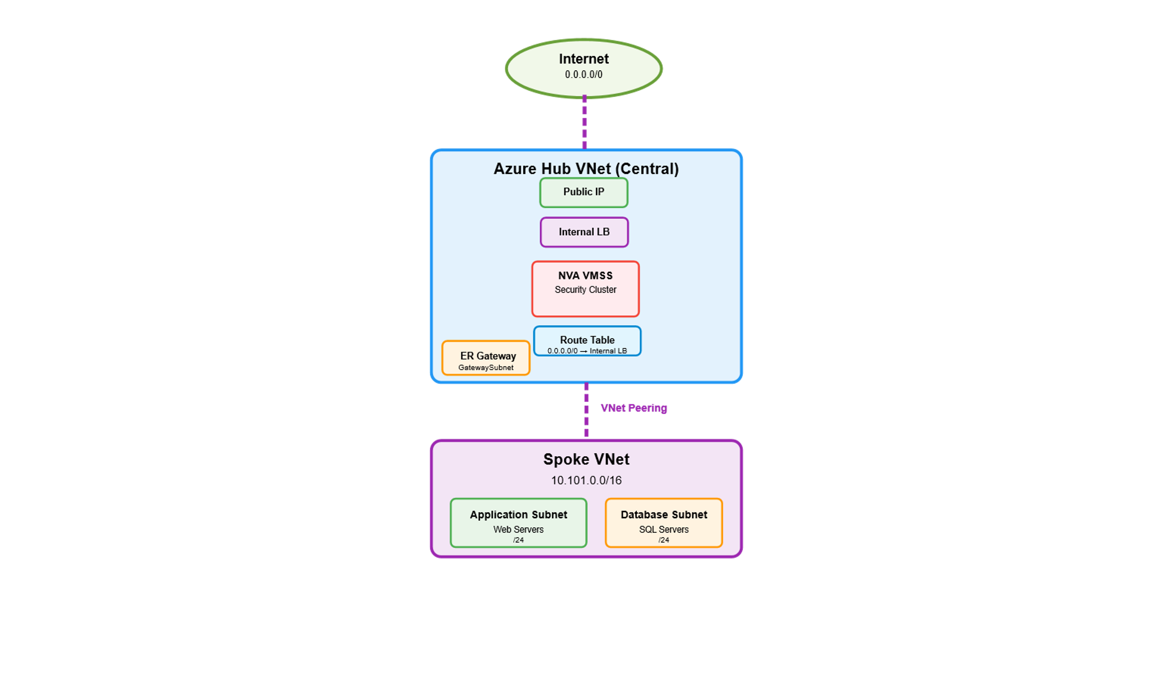
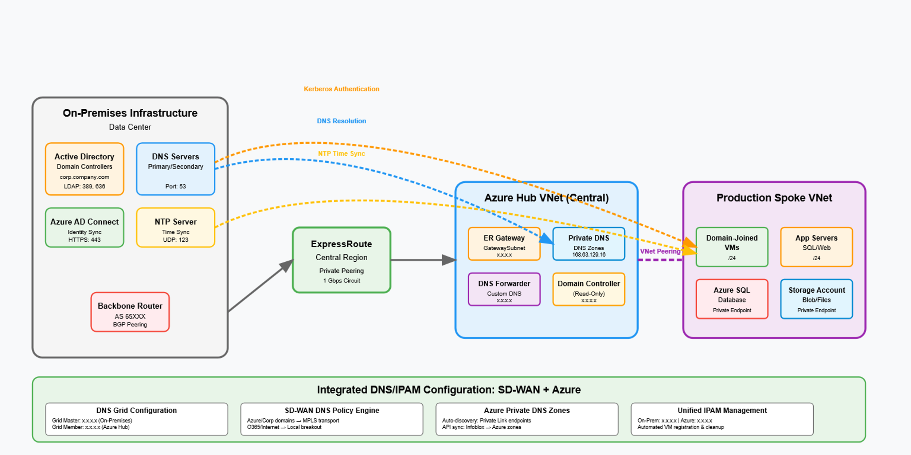
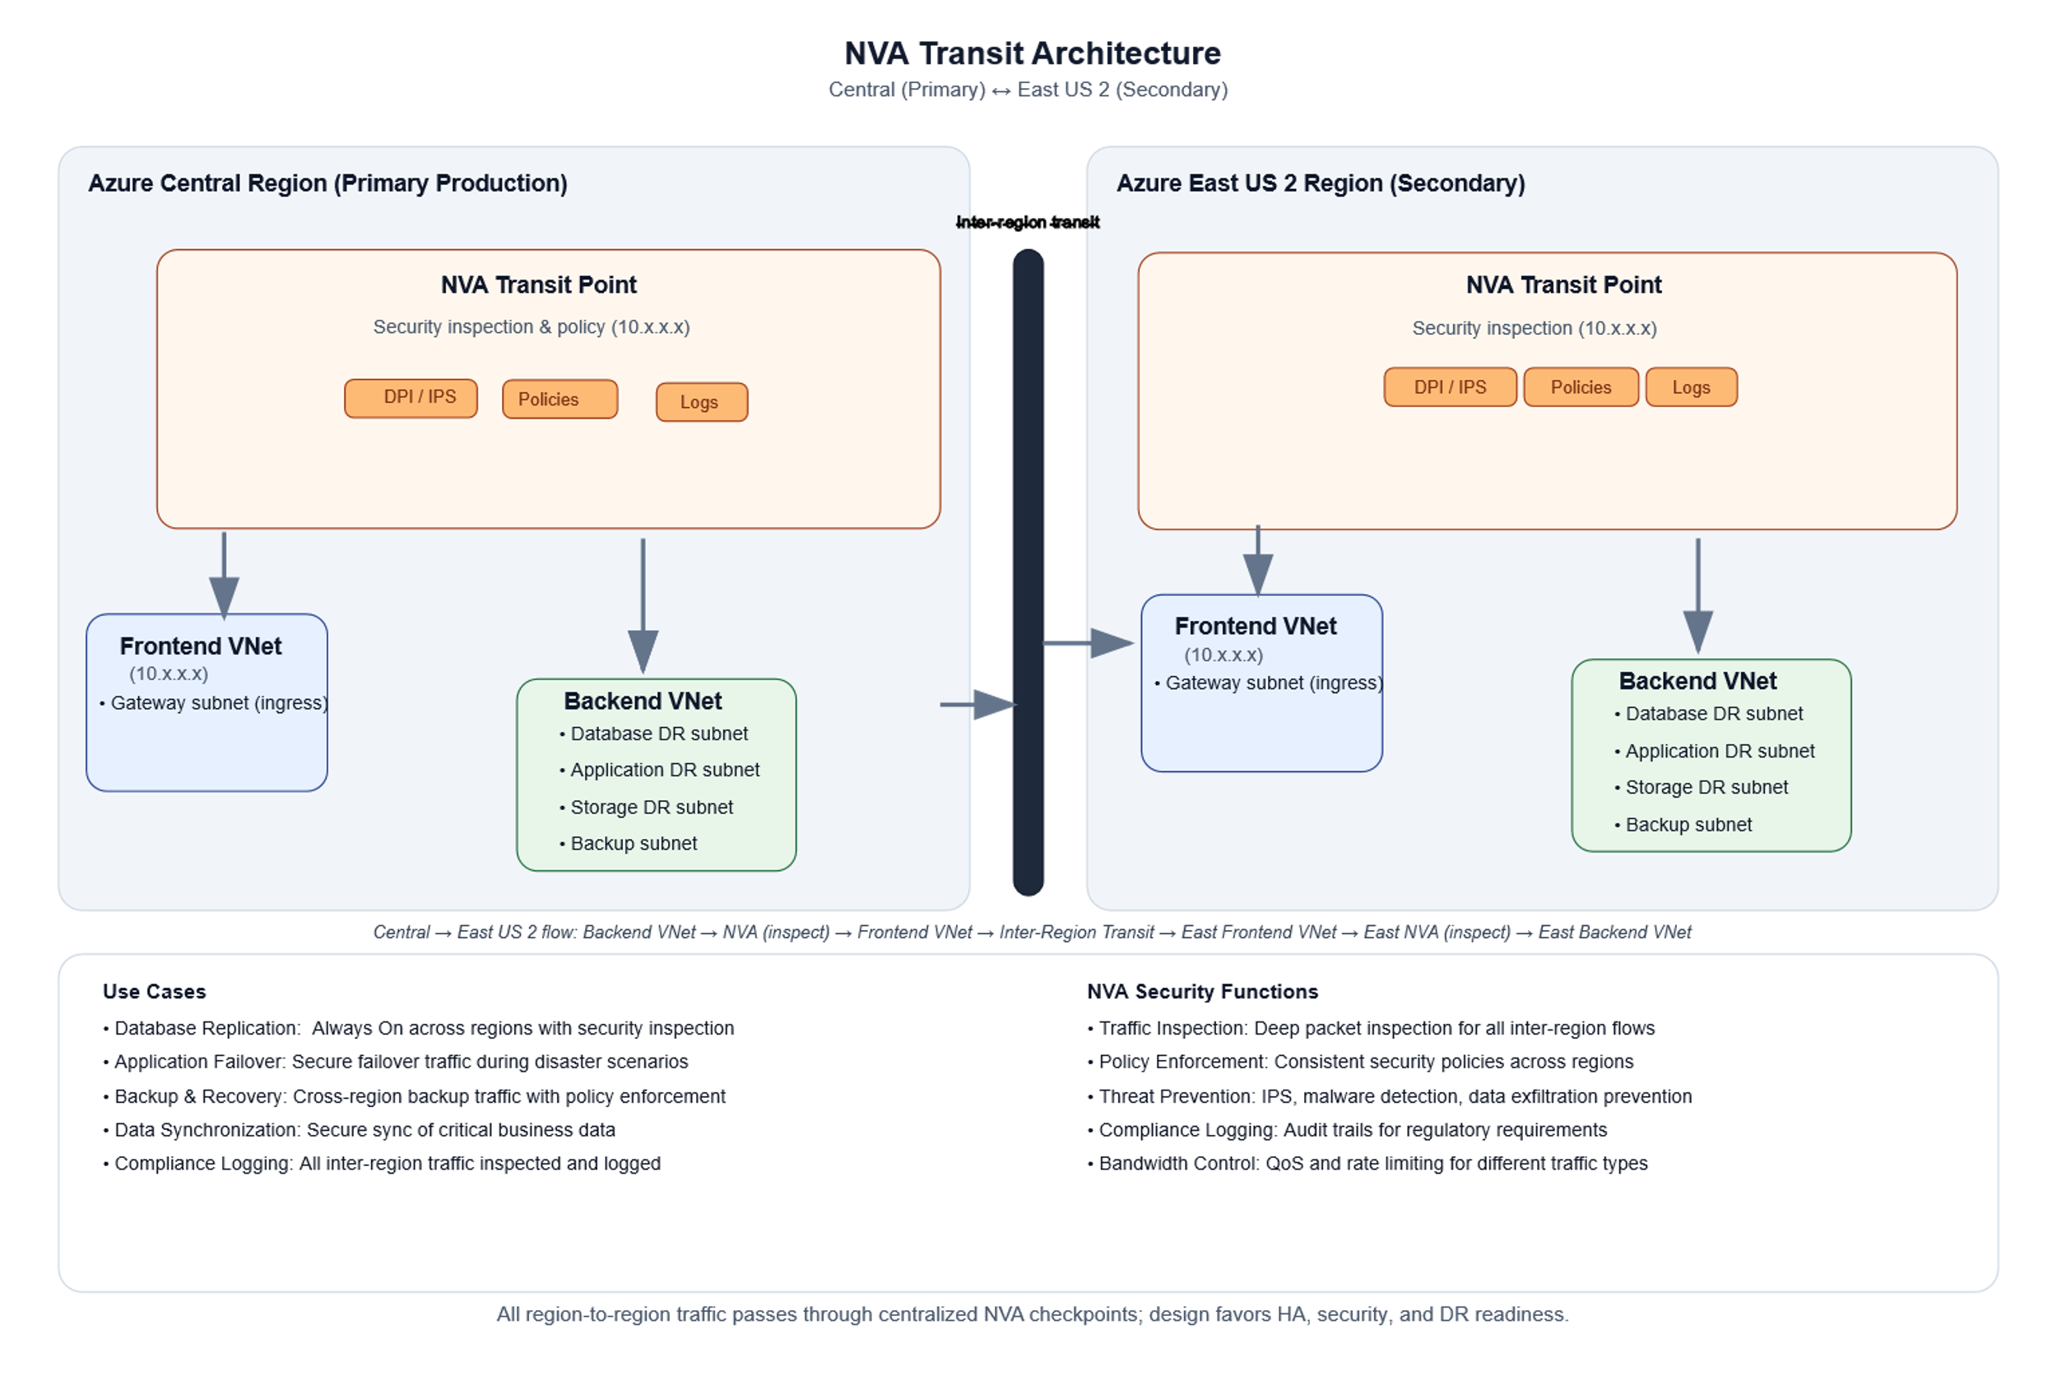
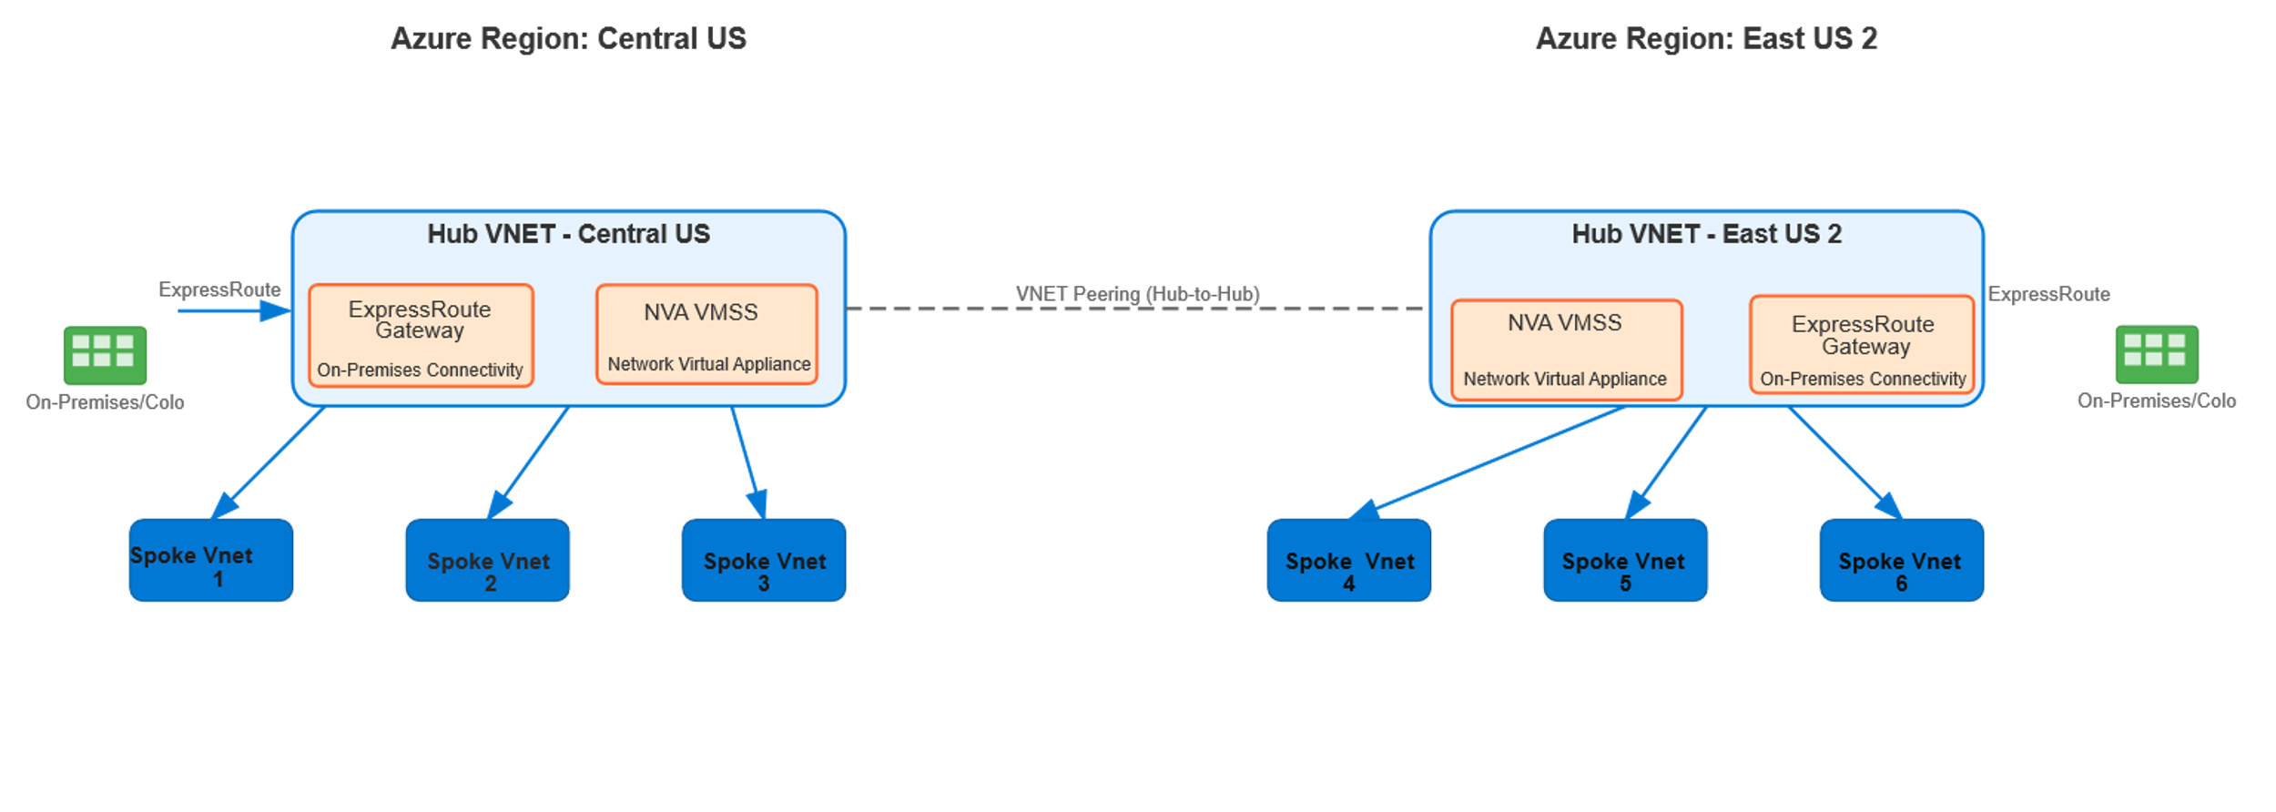
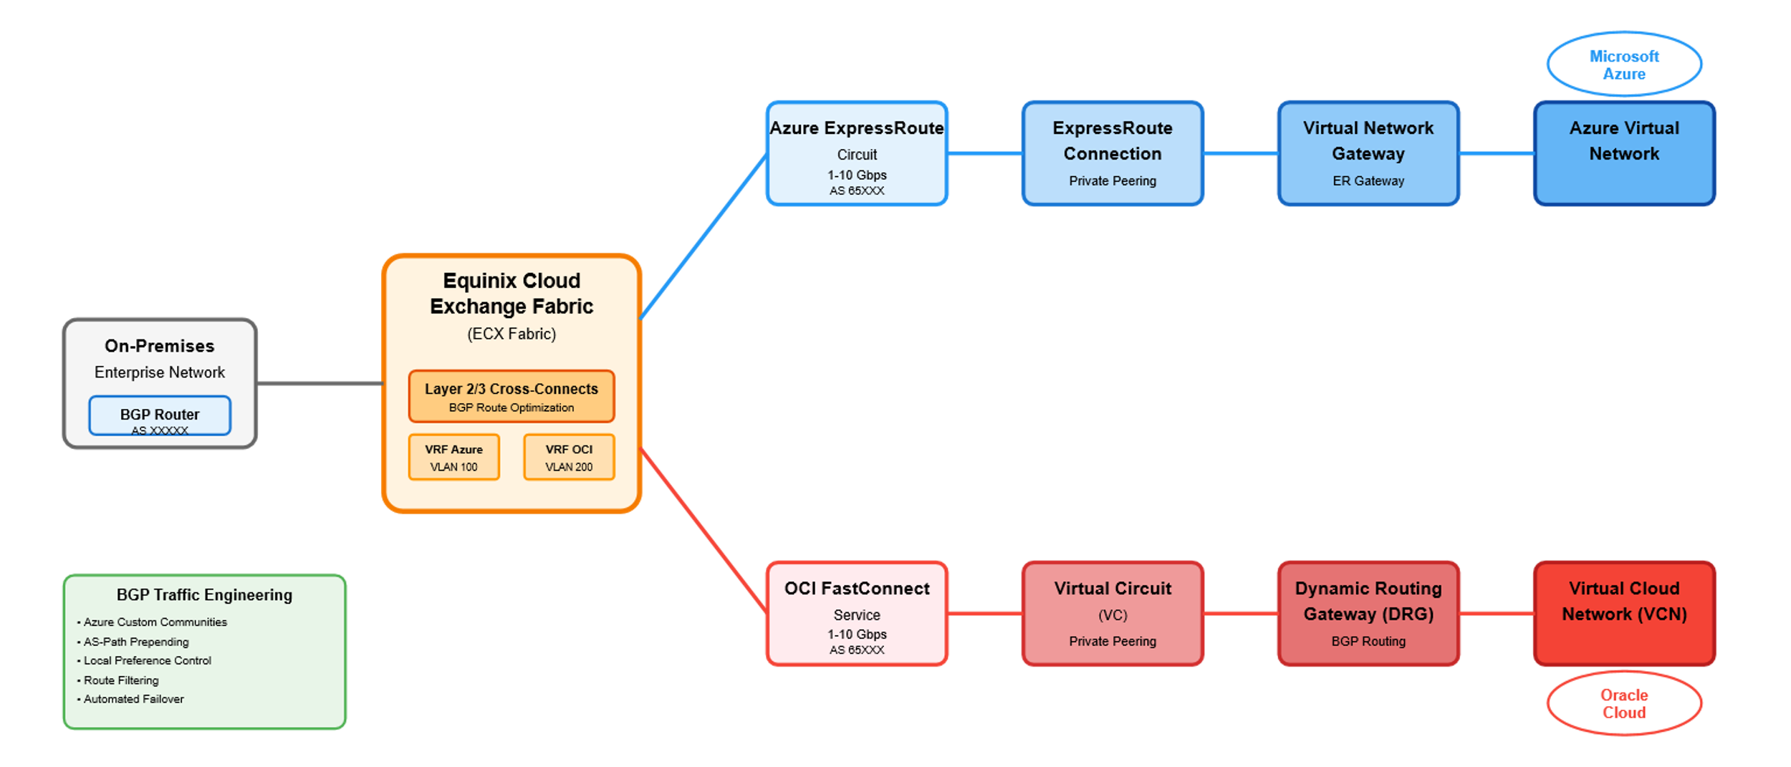
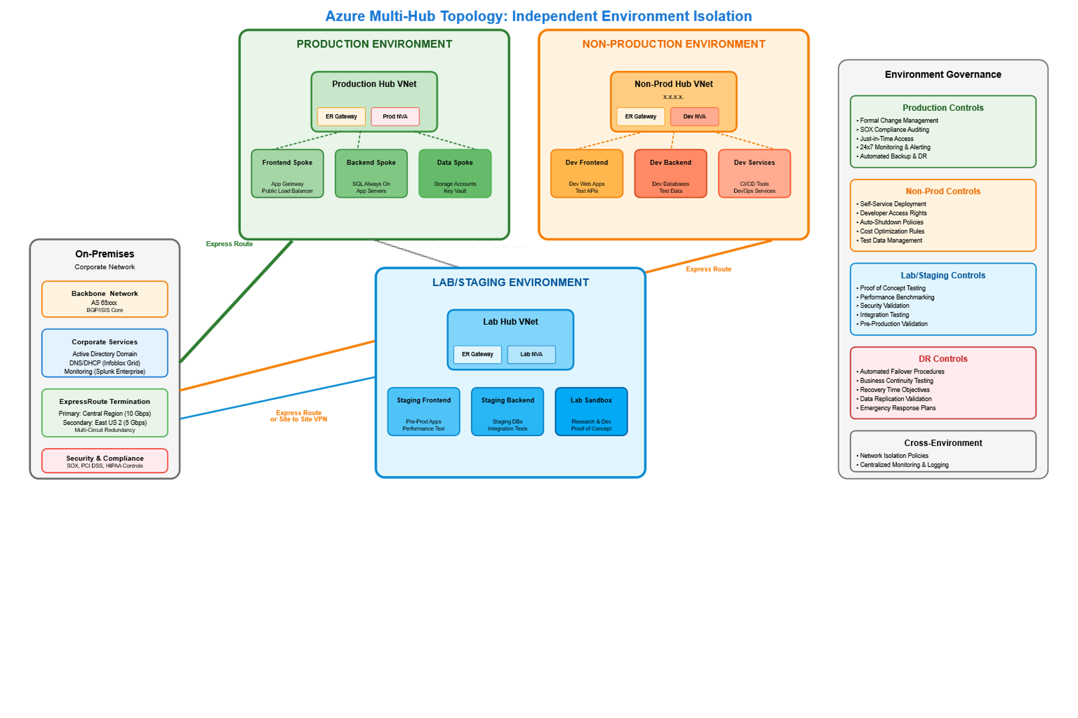

Slide 35
NVA Strategy
Design Recommendations
Checkpoint (GAiA) NVA VMSS
PBR
FortiGate (Zeb) NVA VMSS
Tight integration with Cisco SD-WAN solutions'
Virtual security processing unit (vSPU)
PBR

